Slide 1
Pattern recognition
Introduction to computational thinking

Slide 2
What is pattern recognition?
“Pattern recognition is the process of finding similarities, or patterns, once we go through the decomposition of problems”
- Applied Computational Thinking with Python, Packt, 2020, p. 33

Slide 3
Examples
Data analyst identifies seasonal patterns (peaks every December) => predict future trends & inform decision making
Teacher grading exams: students making the same mistake on a particular question => address common misunderstanding in class, improve learning outcomes

Slide 4
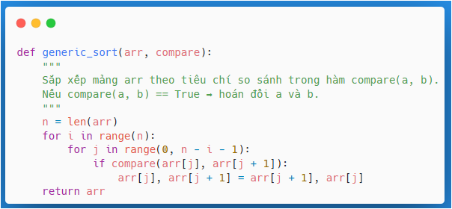
What comes next? Pattern generalization & Reuse
From sorting algorithm for numbers => sort words / other items by defining a comparison rule
Let’s have a look at a sort function in Python:

Slide 5
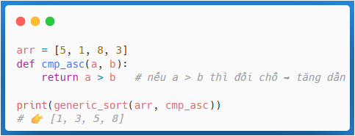
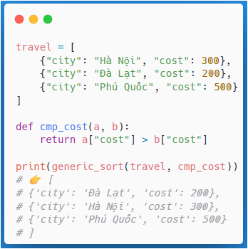
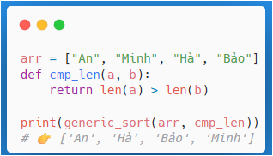
Usage for comparison

Slide 6
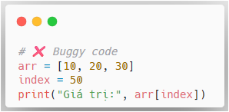
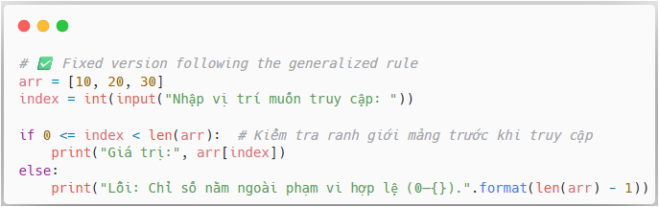
Array bounds
Pattern of bug: Fail to check array bounds
Generalized rule: Always validate indices before access

Slide 7
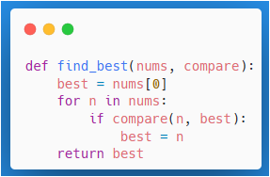
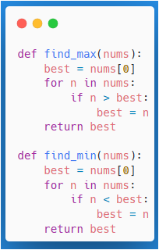
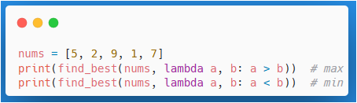
Finding optima

Slide 8
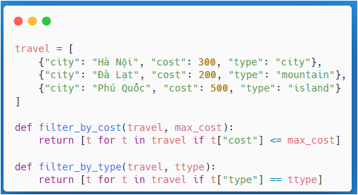
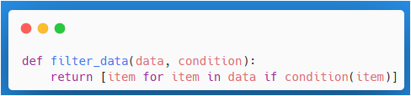
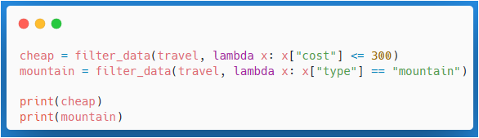
Filter condition

Slide 9
Exercise

Slide 10
Finding patterns
Find similarities or patterns between components for
A course registration system

Slide 11
Suggested
Conflict checking might resemble a scheduling problem
Managing a waitlist has a pattern similar to a queue data structure

Slide 12
Abstraction

Slide 13
What is abstraction?
“Abstraction lets us focus on the things we need and discard things we do not need in order to create the best algorithm for our problem. Now, depending on what we decide we need, we can add or remove some conditions.”
- Applied Computational Thinking with Python, Packt, 2020, p. 35

Slide 14
Examples
OOP: a class represent a concept (Student / Account) abstracting away low-level implementation details
Users of the class call high-level methods without needing to know how they work internally
Robot simulation: 2D grid map abstracts a real room; the robot’s sensors are abstracted as simple inputs like “distance to obstacle.” This model ignores irrelevant details (like wall color or minor irregularities on the floor) to let the algorithm focus on key information for navigation.

Slide 15
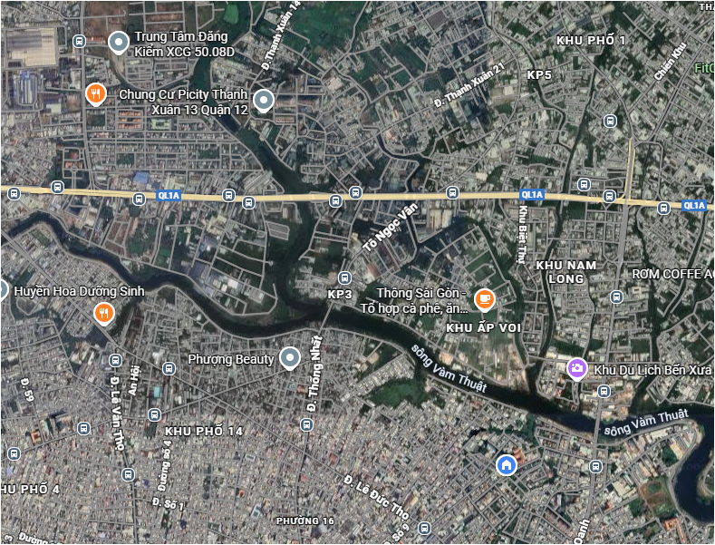
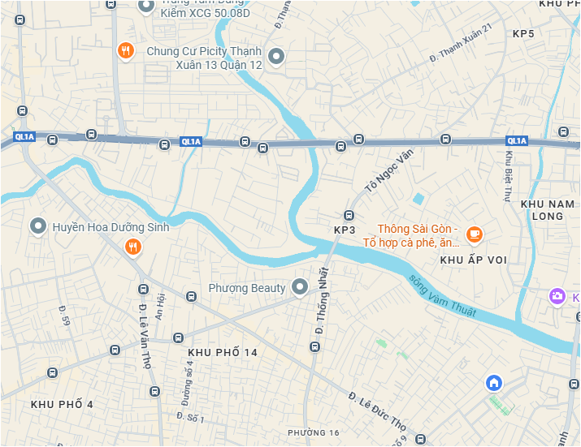
Abstraction with map

Slide 16
Methods of pattern recognition

Slide 17
Core ideas
Compare cases
Identify common points in the data or requirements.
Data grouping (clustering concept)
Group similar elements together.
Frequency and repetition analysis
Identify activities or behaviors that occur frequently.
Generate test cases
Determine input types with similar structures.

Slide 18
Problems of abstraction

Slide 19
1. Over-abstraction
Abstracting too much → losing essential information needed to solve the real problem.
Example: Treating “Travel Planning” as a black box without knowing required inputs or outputs → impossible to implement or test.
Consequences: difficult to implement, hard to validate, and hard to optimize performance.

Slide 20
2. Under-abstraction
Not separating important logic → keeping too many details → making the problem more complex.
Example: splitting steps like “Select Destination → Optimize Route → Suggest Hotels” but still writing all logic in a single function → complex and hard to maintain.

Slide 21
3. Undefined level of abstraction
Not knowing how far to abstract: level too high or too low.
Example: “User Management” is too abstract → missing sub-features like login, profile, preferences.
Or “Optimize Route” becomes too detailed → losing reusability as a module.

Slide 22
4. Mixing abstraction and implementation
Abstraction should describe logic, interface, and data flow, not implementation details.
Example: defining an abstract module “Optimize Route” but including specifics of the A* algorithm → reduces flexibility and makes it harder to replace algorithms.

Slide 23
5. Abstraction not linked to pain points / requirements
Modules are abstracted but nobody knows what pain point they solve.
Consequence: abstract modules that do not address real user problems.

Slide 24
6. Abstraction not reusable / not generalizable
Abstract module only works for one use case → defeats the purpose of abstraction.
Example: “Suggest Hotels for Hanoi Trip” → cannot be reused for Ho Chi Minh City or other destinations.

Slide 25
7. Premature abstraction before validating the problem
Abstraction built on assumptions → if the problem is not well defined, abstraction may go in the wrong direction.
Example: creating an abstract module “AI Tour Recommendation” before validating that users actually need “minimizing travel time” → module may become unnecessary.

Slide 26
8. Abstraction not synchronized across the team
Different team members interpret the abstraction differently → conflicts during implementation.
Example: Developer interprets “Optimize Route” as minimizing time; Designer interprets it as minimizing cost → mismatch.

Slide 27
9. Ignoring non-functional requirements in abstraction
Focusing too much on logic → forgetting performance, scalability, reliability.
Example: abstract “Route Optimization” without considering load time → becomes hard to deploy in real applications.

Slide 28
Tips to avoid abstraction issues
Define the appropriate level of abstraction: high enough to be generalizable, detailed enough to implement.
Keep clear input/output for each abstract module.
Separate logic from implementation: abstraction = interface & behavior; implementation = algorithm / code.
Always link abstraction to pain points, functional and non-functional requirements.
Validate the abstraction with the team & users before implementation.
Document clearly: module name, responsibility, input, output, constraints.
Maintain flexibility to refactor abstraction when requirements change.

Slide 29
Smart travel system

Slide 30
1. User Management (Abstract Module)
Responsibility: manage user information, authentication, preferences
Input: user info, login credentials, preferences
Output: user profile object, auth token
Pain Points: simplify account setup & personal preference configuration

Slide 31
2. Travel Planning (Abstract Module)
Responsibility: generate itineraries based on user requirements
Input: destinations, dates, preferences, budget
Output: itinerary object, optimized route, recommended hotels/tours

Slide 32
Sub-abstractions
Destination Selection
Input: preferences, available destinations
Output: selected destinations
Pain Point: too many choices, difficult decision-making
Route Optimization
Input: selected destinations
Output: ordered route
Pain Point: minimize travel time
Suggest Hotels & Tours
Input: selected destinations, user budget
Output: recommended hotels/tours
Pain Point: comparing prices and reviews is time-consuming

Slide 33
3. Booking Services (Abstract Module)
Responsibility: handle service bookings
Input: selected hotels/tours/flights
Output: booking confirmation, payment token
Pain Point: seamless connection, fewer manual steps

Slide 34
4. Map & Navigation (Abstract Module)
Responsibility: display routes & provide navigation support
Input: optimized route
Output: map visualization, directions
Pain Point: clarity, intuitiveness; offline & real-time traffic

Slide 35
5. Admin / Backend (Abstract Module)
Responsibility: manage data, analyze user behavior
Input: data from system & users
Output: analytics, reports, updated data
Pain Point: managing large datasets, avoiding manual errors

Slide 36
6. External APIs (Abstract Module)
Responsibility: provide external data (maps, weather, booking)
Input: API requests
Output: API responses
Pain Point: ensuring reliability, handling API rate limits

Slide 37
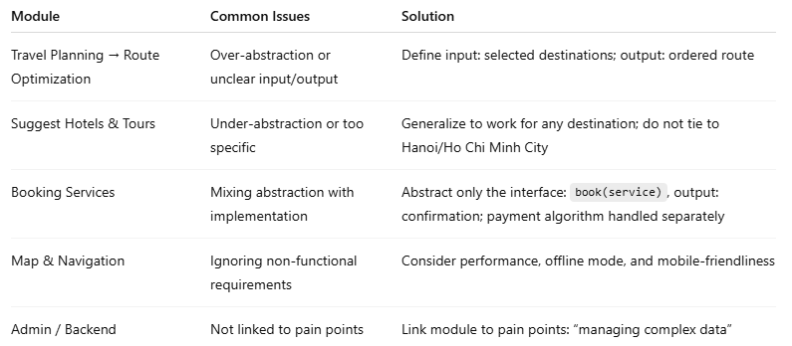
Common problems

Slide 38
Tips
For each abstract module → clearly specify responsibility, input, output, and related pain points.
Avoid writing algorithm details in the abstraction → keep the logic at a high-level.
Draw dependency arrows: which module depends on which (e.g., Travel Planning → Map & Navigation).
Maintain general and reusable abstractions to allow future expansion.

Slide 39
Discussion

Slide 40
Discussion
Model a smart home thermostat system.
What details matter for the model and what details can be ignored?

Slide 41
Suggested solution
What details matter for the model?
-> current temperature
-> target temperature
-> time of day
What details can be ignored?
-> the color of the thermostat

Slide 42
Case study
John Snow solved 1854 cholera outbreak in London

Slide 43
The Golden Square outbreak
Worldwide 1846–1860: cholera pandemic
Killed 616 people
John Snow's study:
The cause: germ-contaminated water
Not "miasma" in the air
Influence to today: construction & improved sanitation facilities
1854 Broad Street cholera outbreak - Wikipedia

Slide 44
How John Snow solved the problem?
1. Decomposition: dividing the city into zones and working on each zone individually
2. Pattern recognition:
Narrow down the origin of the infection to the zone with the earliest cases
Find the areas with the highest density of the infected populace
3. Abstraction: interviews to eliminate people who were not infected from breathing the same air => the mode of infection wasn’t airborne
4. Algorithm: Use calculations & diagrams to pin down the point of origin

Slide 45
Case study
Fake news detection

Slide 46
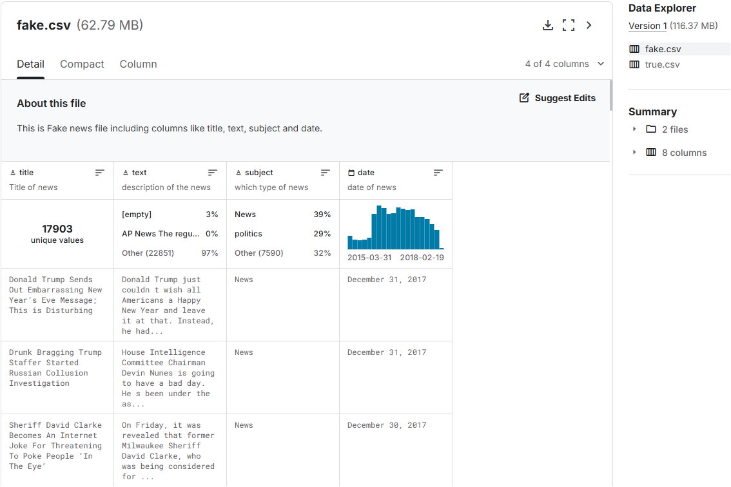
Dataset from Kaggle
https://www.kaggle.com/datasets/jainpooja/fake-news-detection

Slide 47
Sample source code
https://www.kaggle.com/code/tdquang/fake-news-detection
What should we do when we have the data?
=> 1. Inspect
=> 2. Read into DataFrame
=> 3. Restructuring (add columns, remove unwanted columns)
=> 4. Reserve some data for testing later
=> 5. Shuffle the data for training
=> 6. Remove unwanted special characters

Slide 48
Do the training
1. Split into train & test
2. Convert to vectors
3. Train
Logistic regression
Decision tree
Gradient Boost
Random Forest

Slide 49
Evaluation
Precision
Recall
F1-Score
Manual testing
Other types of data?

Slide 50
Case study
SmartTourRoutePlanner: Tourism Route Dataset

Slide 51
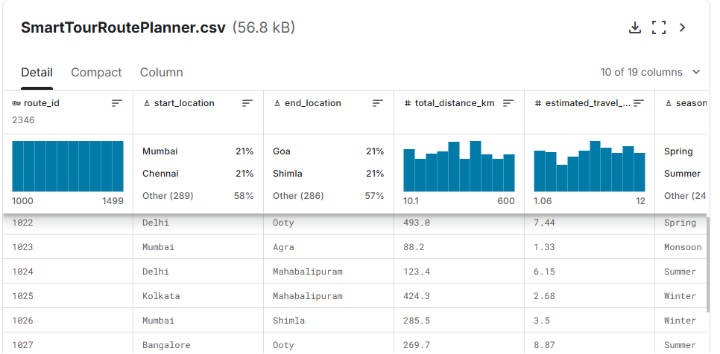
Data set from Kaggle
https://www.kaggle.com/datasets/ziya07/smarttourrouteplanner-tourism-route-dataset

Slide 52
Sample source code
https://www.kaggle.com/code/tdquang/smarttravel-tourism-route-dataset

Slide 53
Possible followup
Find an optimal journey: use cost, time, distance, … as the objective function
Apply optimization algorithms such as A* search, Dijkstra’s algorithm or heuristics to find the route between points of interest (POIs)
Classification / user recommendation: build a classification model to predict “should the user choose route A or route B” based on the user profile (preferences, budget) and the route data

Slide 54
Activity
Find one travel dataset on Kaggle
Inspect & extract meaningful data on it

Slide 55
Ideas - Weekend activities
Coffee?
Tiktok / Facebook?
Info?
Review?
Suggest image pose?

